Slide 1
Cough Syrup Recipe
SFC Construct Example
Prepared by: Mike Power, Manager BearingPoint Life Sciences
February 27, 2007 Revision 1.0

Slide 2
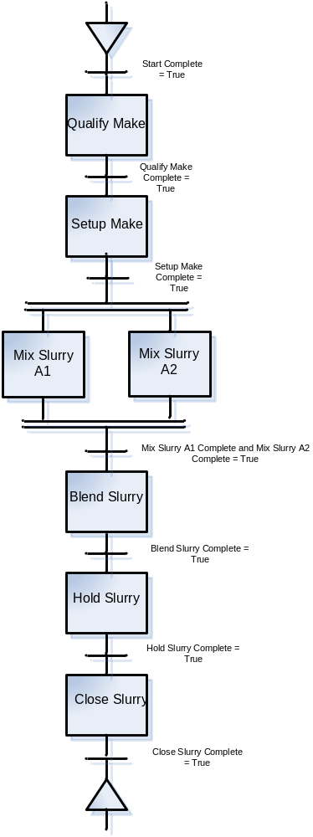
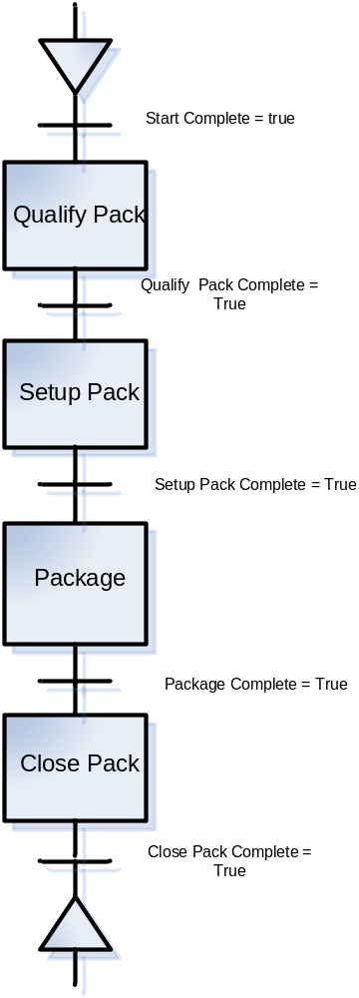
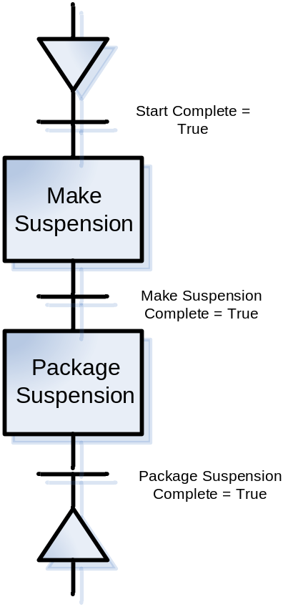
Cough Syrup Recipe
Cough Syrup Recipe Procedure
Make Suspension Unit Procedure
Package Suspension Unit Procedure

Slide 3
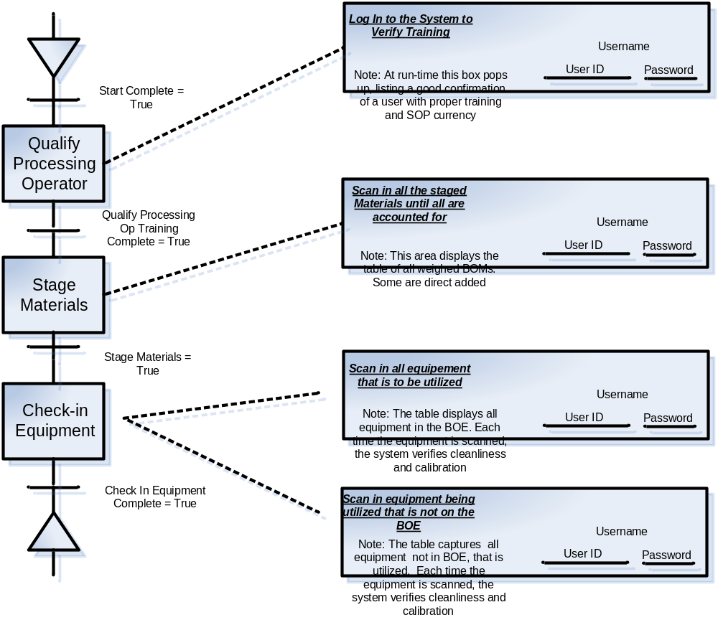
Qualify Make Operation
Re-usable Actions
Phases
Signature Strategy
Instruction
Note: Each Action must have a GMP instruction and a signature strategy. The signature strategy is:
Initial
Single Signature
Double Signature
No Signature
Multiple Actions
Notes:
New red mark
Our goal is to position the brand
Reposition a consistent message that captures the spirit and soul of BearingPoint
Our goal is to have every employee understand our messaging, embrace it with pride and demonstrate in every way, everyday

Slide 4
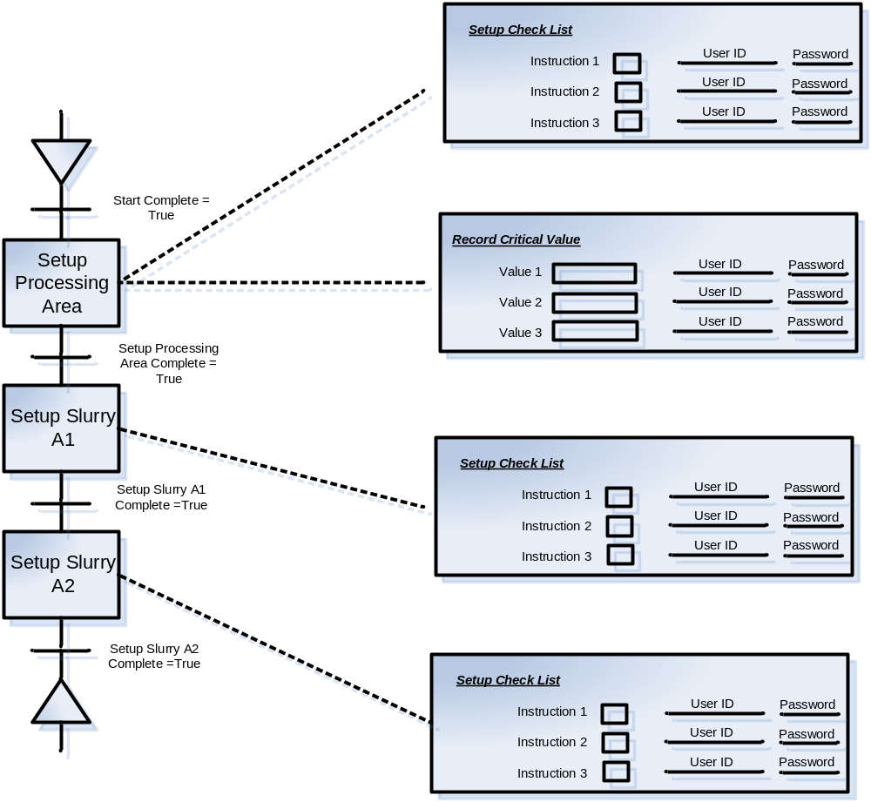
Setup Make Operation
Data Capture
Note: On data capture, there is a potential to validate the data against a known value. i.e. Is the value between a limit? Is the value = to a limit. Is the value > a limit, Is the value < # & > #.

Slide 5
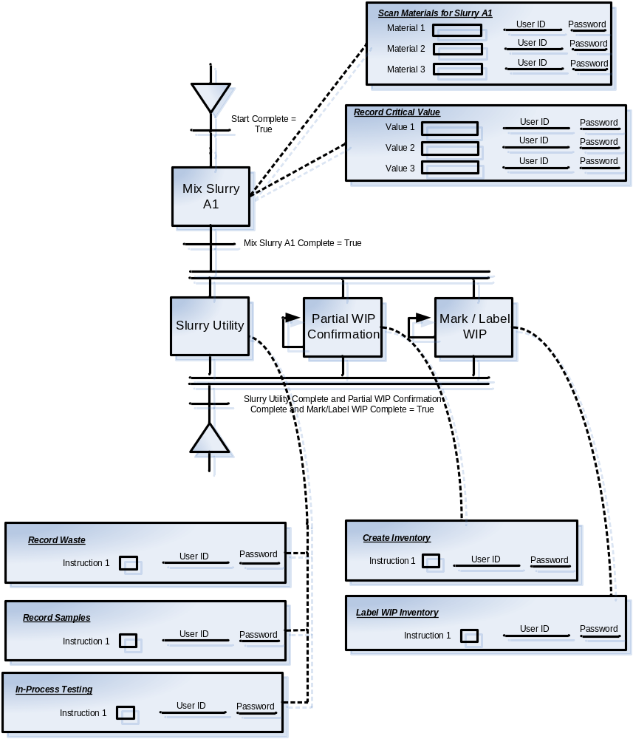
Make Slurry A1 Operation
Note: Indicates an action that can be repeated

Slide 6

Make Slurry A2 Operation

Slide 7
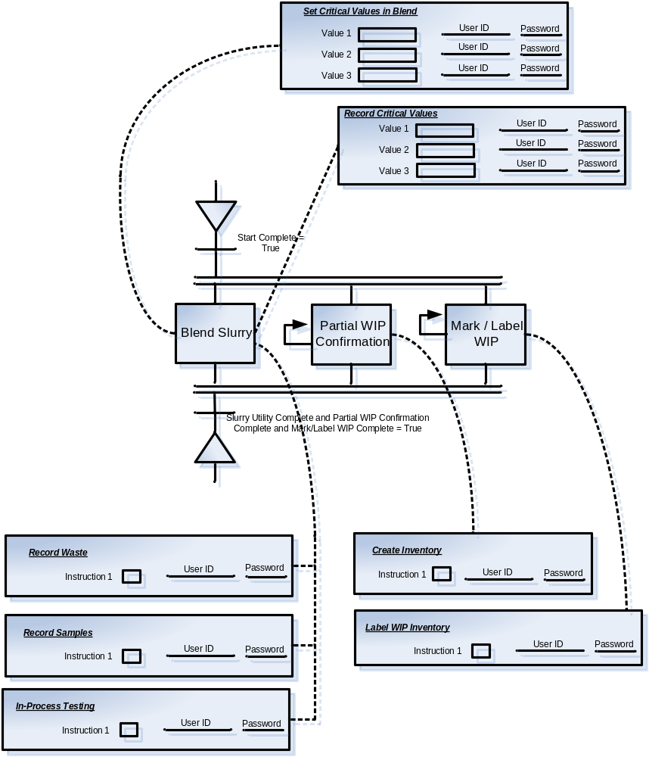
Blend Slurry Operation

Slide 8
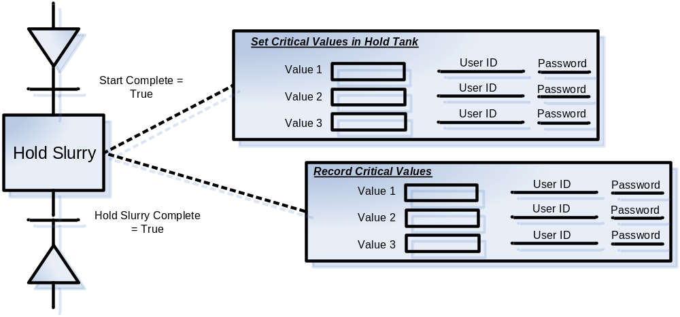
Hold Slurry Operation

Slide 9
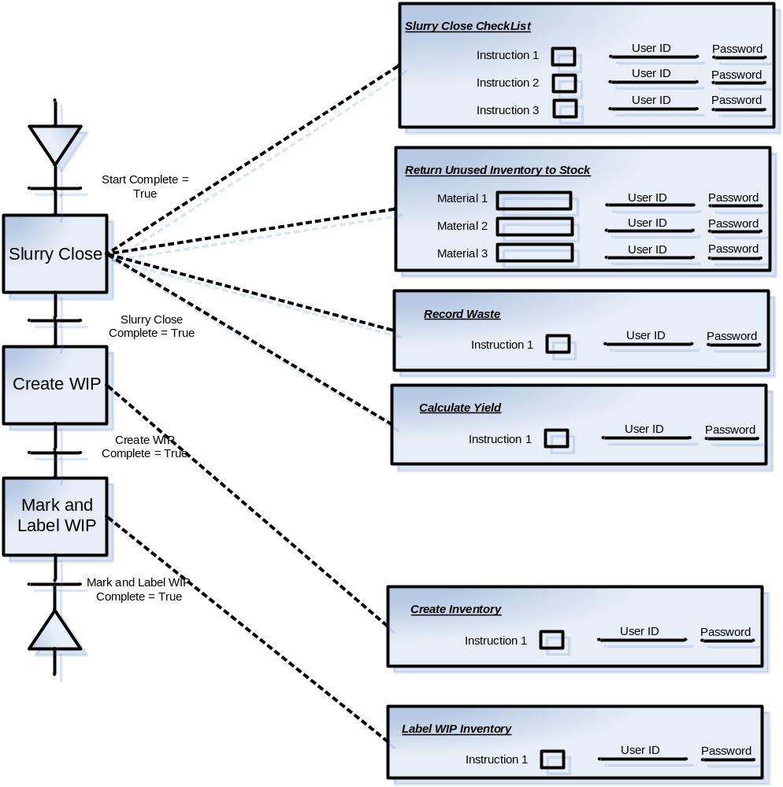
Close Slurry Operation

Slide 10
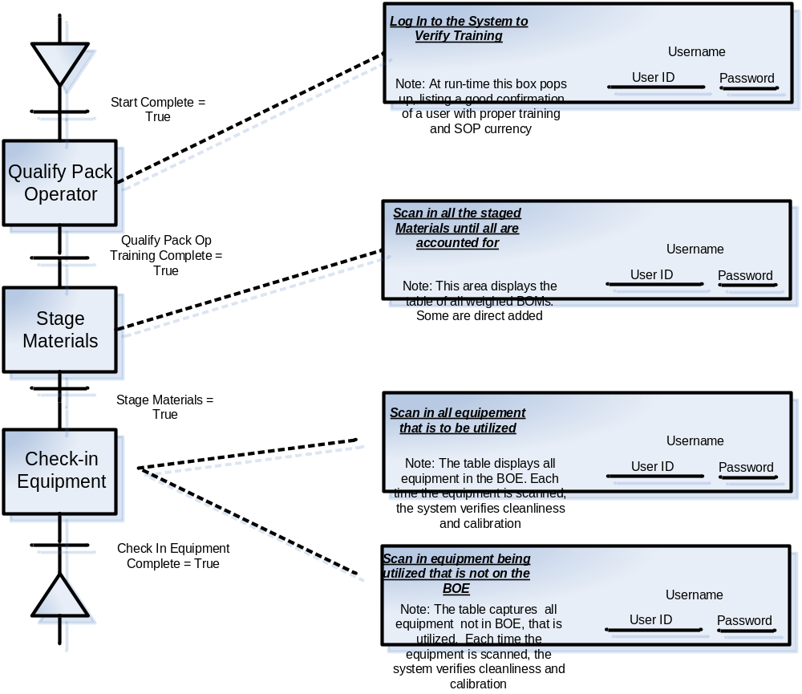
Qualify Pack Operation

Slide 11
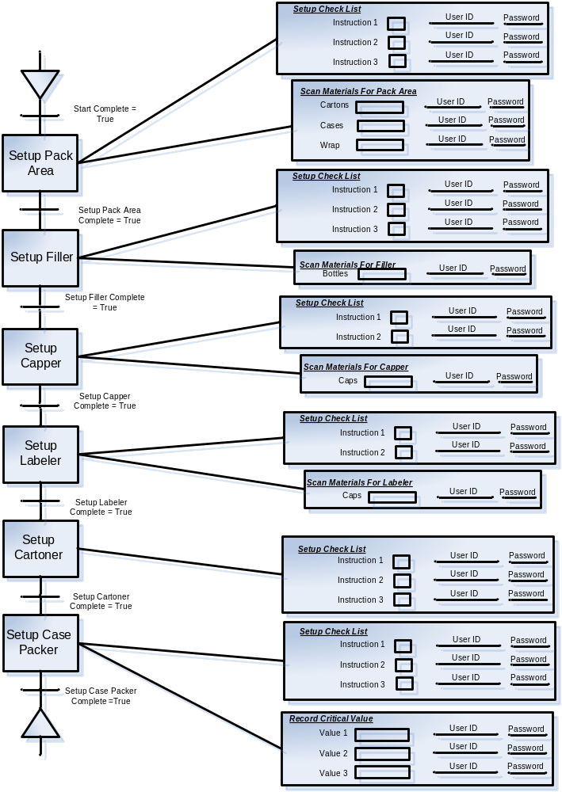
Setup Pack Operation

Slide 12
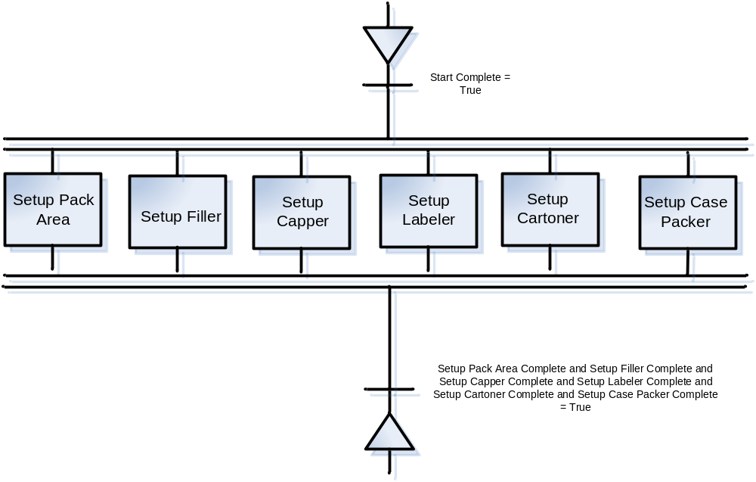
Alternate Setup Pack Operation

Slide 13
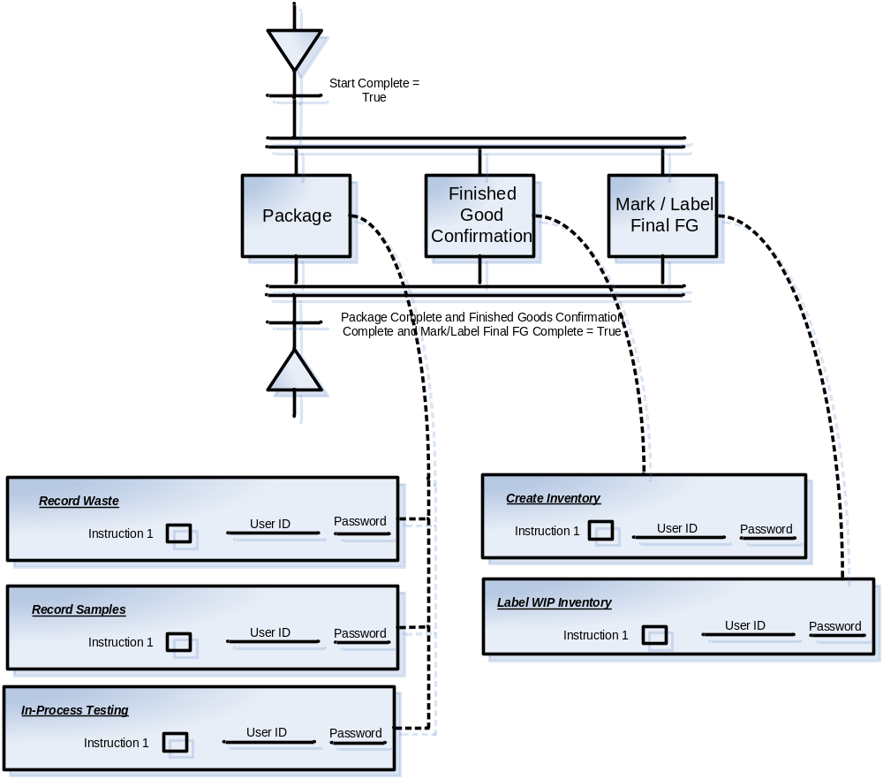
Pack Operation

Slide 14
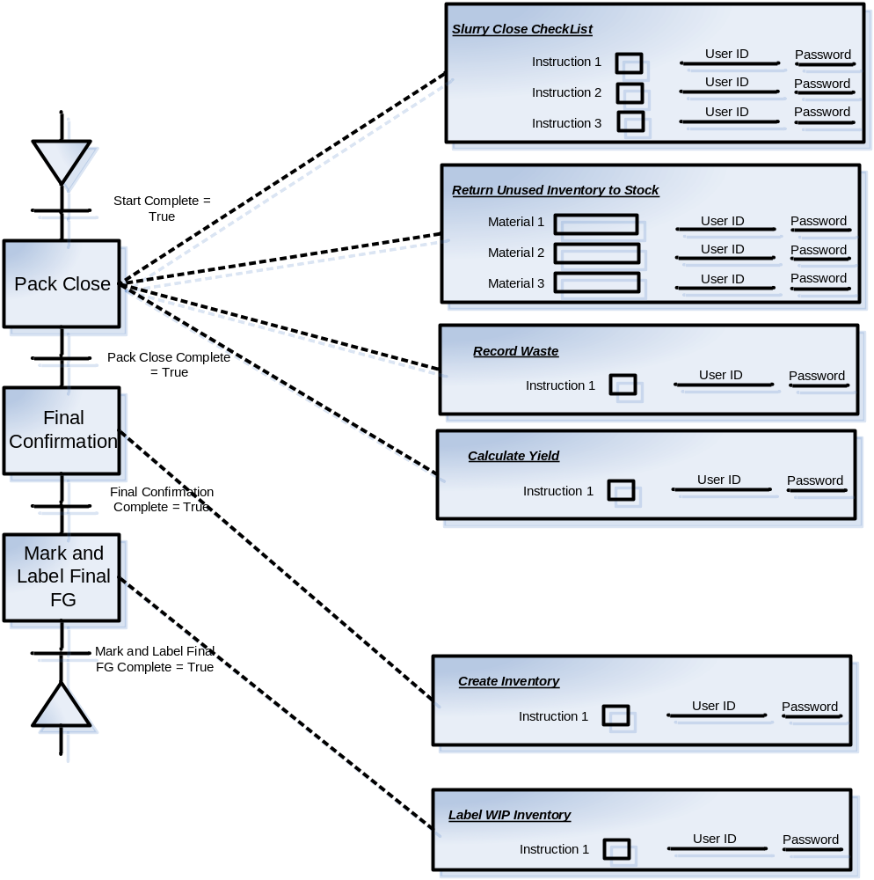
Close Pack Operation

